Slide 1

IOT Based Smart System for Protection of Railway Workers
Lokmanya Tilak College of Engineering
Department of Electronics and Telecommunication
Project Stage - II
Jaitali Sathale Manali Jadhav
Shruti Naik Reshama Gurav
Guide Name: Dr. Ravindra Duche

Slide 2
Contents
Introduction
Problem Definition
Literature Survey
Methodology
Design Steps or Proposed System
Implementation
Advantages
References
Certificates

Slide 3
Introduction
Indian Railways is the largest railway network under a single management in the world.
With such a massive utilization of assets, Safety is of paramount importance for operational efficiency.
Track workers working in the rail corridor are faced with the possible danger of trains and other track machinery moving through their worksite.
The solution is a comprehensive ultrasonic sensor & GSM based system.

Slide 4
Problem Definition
Main objective is to make a device which will warn the construction workers working on train tracks about approaching trains.
As working in railway construction, there are a number of hazards to be considered.
Train accidents at work sites are on increase in Indian Railway.
However, it is seen that contractors are allowed to start the work without ensuring provisioning of barricading, or other safety alert device, etc.

Slide 5
Literature Survey
Referred Paper 1
Three SCR workers killed as train engine knocks them down: This paper review the literature of lack of safety device available and negligence of that department thus situation occur.
Referred Paper 2
Track repair workers to get safety device to warn of incoming trains: This review the literature in view that the committee is also trying to overcome through this condition and get more awareness on the worker health safety also.
Referred Paper 3
Personal workforce protection: The purpose of this review is to establish a baseline for the researcher interested in the area. It conclude with a call for further research into the more innovative possibilities of improving the safety device system.

Slide 6
Methodology
Gathering information
Proper Planning
Block diagram
Connecting Sensors and other modules with Arduino
Testing that Alert message is received to workers through SMS
Implementation on Hardware.

Slide 7
Block diagram:
BUZZER
MOBILE
Wireless communication
GSM MODULE
ARDUINO
ULTRASONIC SENSOR

Slide 8
Components :
Arduino Nano
Ultrasonic sensor
Buzzer
GSM Module SIM 900A
Mobile

Slide 9
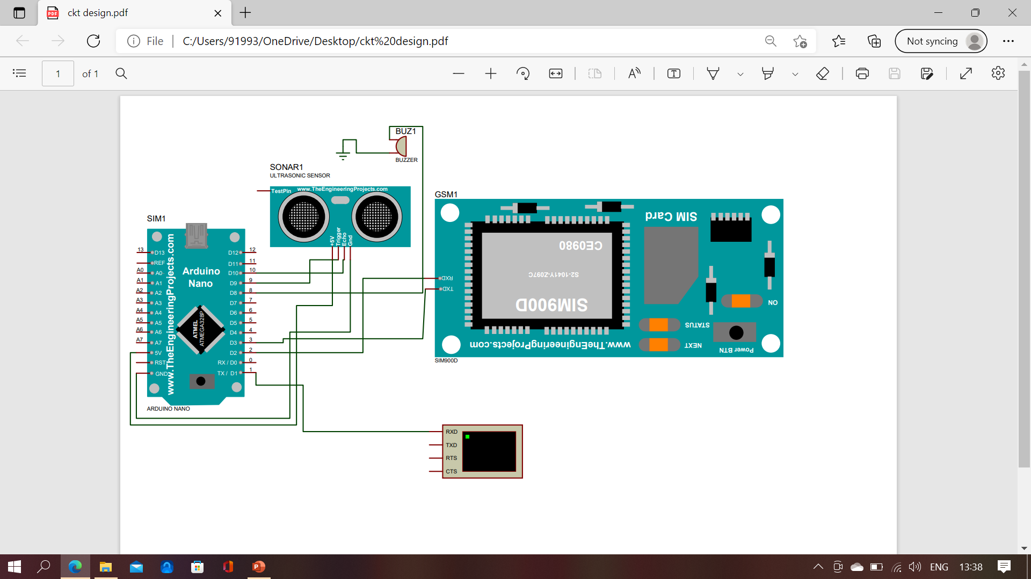
Proposed System

Slide 10
Working:
In this process, the first step is to detect the train through the ultrasonic sensor which is connected to Ardiuno.
After detecting the train it will send the information through GSM module.
And the alert message will be received to the worker.

Slide 11
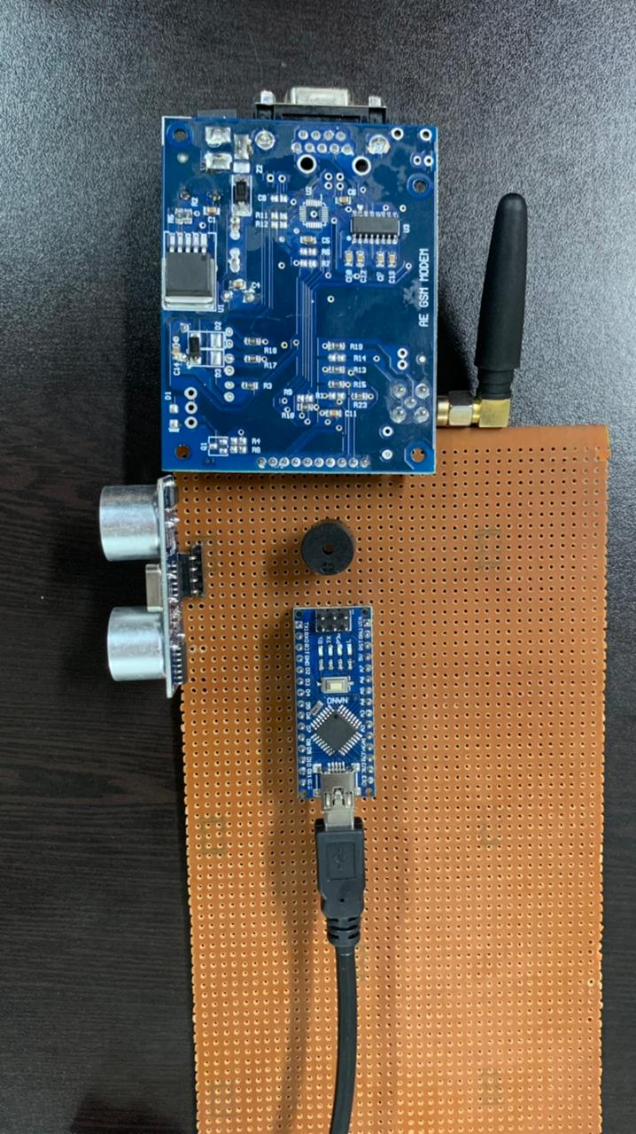
Implementation

Slide 12
Adavantages
Cost effective
Easily available
Portable device
Reduce major falling accident.

Slide 13
References
V. KAVITHA, & MAHESHWARI.M. (2021). IOT BASED CRACK DETECTING, OBSTACLE DETECTING AND ENERGY MINIMIZING ROBOT IN RAILWAY TRACK. International Journal of Innovations in Engineering Research and Technology, 6(6), 1–5. Retrieved from https://repo.ijiert.org/index.php/ijiert/article/view/1851
https://safety.indianrail.gov.in/sims/
https://www.railwaypro.com/wp/minimize-human-error-and-protect-workers-with-protran-technology-railway-worker-protection-systems/
https://www.railway-technology.com/features/getting-on-track-with-safety-for-railway-workers/
https://www.thehindu.com/news/cities/Hyderabad/three-scr-workers-killed-as-train-engine-knocks-them-down/article32165181.ece
https://www.ndtv.com/india-news/track-repair-workers-to-get-safety-device-to-warn-of-incoming-trains-1811366

Slide 14

Certificates
Smart India Hackathon 2022

Slide 15
Thank You

